Slide 1
SPOT WELDER
Done by,
Ben K Jose
Bibin V Babu
Aylikunnel Simon Sunny
Project Guide,
Dr. Therese Yamuna Mahesh

Slide 2
CONTENTS
Introduction
Literature Survey
Working
Description of system components
Circuit diagram and Block diagram
Hardware Design
Result
Photo of Circuit
Photo of Product
Conclusion
References

Slide 3
INTRODUCTION
Technology is rapidly growing and it is important to explore different parts of welding processes in our day today life. Many electrical, mechanical and automobile industries uses this technology for welding purposes.
During spot welding, the large electric current induces a large magnetic field, and the electric current and magnetic field interact with each other to produce a large magnetic force field too, which drives the melted metal to move very fast at a velocity up to 0.5 m/s.
As such, the heat energy distribution in spot welding could be dramatically changed by the fast motion of the melted metal. The fast motion in spot welding can be observed with high-speed photography.

Slide 4
LITERATURE SURVEY
Donders S, Brughmans M, Hermans L, Tzannetakis N: ‘The effect of spot weld failure on dynamic vehicle performance’
Spot welds are the dominant joining method in the automotive assembly process. As the automated assembly process is not perfect, some spot welds may be absent when the vehicle leaves the assembly line.
First, the impact of spot weld quality and design on a vehicle’s functional performance is reviewed, addressing strength and stiffness, NVH and durability. The overview briefly covers both experimental tests and predictive finite element (FE) modeling approaches, explains the complexity of a spot weld design problem and discusses optimization strategies.
Second, an industrial robustness study is presented, that assesses the effect of spot weld failure on dynamic vehicle characteristics.

Slide 5
WORKING
The AC mains voltage is step down to 3V in secondary winding with manually winded secondary coil of a 300W transformer
The transformer is of 300W we can get approximate 100A at 3V without considering the efficiency of transformer and it's loses
This high current need to be controlled inorder for getting a perfect welding for lithium batteries with the nickel strip
So the welding time can be controlled manually by using the potentiometer provided

Slide 6
DESCRIPTION OF SYSTEM COMPONENTS
Components
SL NO | NAME OF THE COMPONENT | SPECIFICATION | QUANTITY
1. | 300 WATTS TRANSFORMER |  | 1
2. | ARDUINO UNO |  | 1
3. | ROTARY TYPE POTENTIOMETER | 10K | 2
4. | RELAY MODULE |  | 1
5. | RESISTOR | 10K | 1
6. | LCD DISPLAY |  | 1
7. | PUSH BUTTON |  | 1
8. | WIRE | 32mm

Slide 7
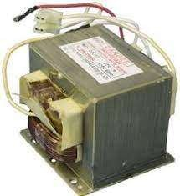
300 WATTS TRANSFORMER
When the magnetron of the microwave oven transformer works, an oscillating current flows in the secondary high-voltage winding of the transformer, causing the iron core to generate magnetic saturation.
The microwave oven transformer mainly maintains the working current of the magnetron by the leakage magnetic flux, so it is also called the magnetic leakage transformer.
This transformer can maintain the stability of the magnetron anode current under a wide range of city power fluctuations, so it has been widely used in microwave ovens.

Slide 8
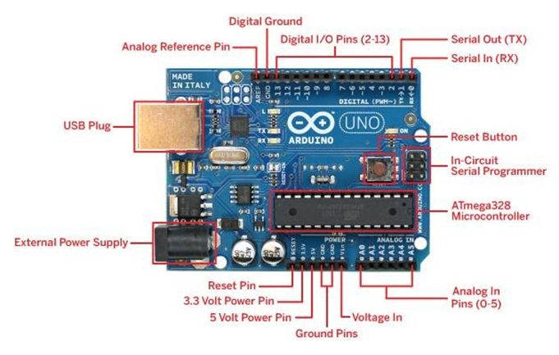
ARDUINO UNO
Arduino UNO is a microcontroller board based on the ATmega328P. It has 14 digital input/output pins 6 analog inputs, a 16 MHz ceramic resonator , USB connection, a power jack, an ICSP header and a reset button.
It contains everything needed to support the microcontroller, simply connect it to a computer with a USB cable or power it with a AC-to-DC adapter or battery to get started.
It can be powered by the USB cable or by an external 9- volt battery, through it accepts voltages between 7 and 20 volts.

Slide 9
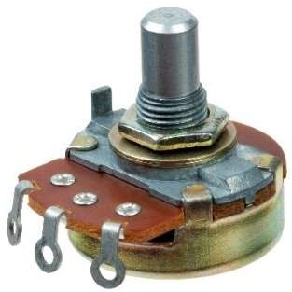
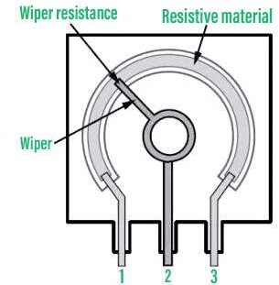
ROTARY TYPE POTENTIOMETER
A potentiometer is a three-terminal resistor with a sliding or rotating contact that forms an adjustable voltage divider. If only two terminals are used, one end and the wiper, it acts as a variable resistor or rheostat.
Used to control electrical devices such as volume controls on audio equipment.
The rotary type potentiometers are used mainly for obtaining adjustable supply voltage to a part of electronic circuits and electrical circuits.

Slide 10
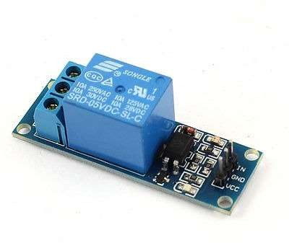
RELAY MODULE
The SPDT Relay is a high quality Single Pole Double Throw Relay(SPDT).
The Relay consists of a coil, 1 common terminal, 1 normally closed terminal, and one normally open terminal.
When the coil of the relay is at rest (not energized), the common terminal and the normally closed terminal have continuity. When the coil is energized, the common terminal and the normally open terminal have continuity. This relay's coil is rated up to 5V and the contact is rated up to 30A (250VAC, 30VDC).

Slide 11
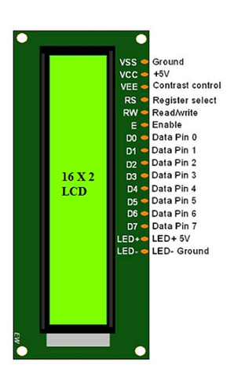
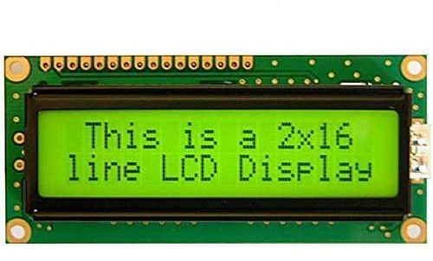
LCD DISPLAY
It is an 16x2 LCD Module.
The operating voltage of this LCD is 4.7V-5.3V.
It includes two rows where each row can produce 16-characters.
The utilization of current is 1Ma with no backlight.
Every character can be built with a 5×8 pixel box.
The alphanumeric LCDs alphabets & numbers.
Is display can work on two modes like 4-bit & 8-bit.
These are obtainable in Blue & Green Backlight.
It displays a few custom generated characters.

Slide 12
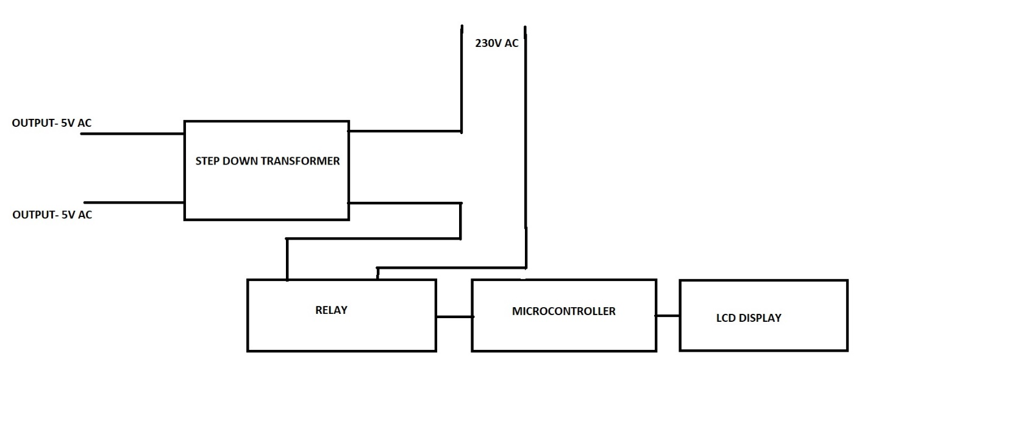
CIRCUIT DIAGRAM AND BLOCK DIAGRAM

Slide 13
HARDWARE DESIGN
We designed a power supply for our project in pcb and the steps are as follows:
Step 1- Opened Altium designer and created a folder.
Step 2- Then the schematic is made by adding the libraries to the Altium.
Step 3- Updated the schematic to the PCB format.
Step 4- Checked each component with the schematic as all components are present in the PCB layout.
Step 5- Components are placed accordingly inside the PCB layout.
Step 6- Then the reroute is being done.
Step 7- Next polygon pour is done to create a solid area on PCB layer.
Step 8- Then we move to the files and click the fabrication outputs.
Step 9- Next, we click the Gerber files,once creating Gerber files.
Step 10- We create the Gerber x2 files by clicking the Gerber x2 icon.
Step 11- Click the final and the dot files will be obtained.
Step 12- The final PCB layout is obtained.

Slide 14
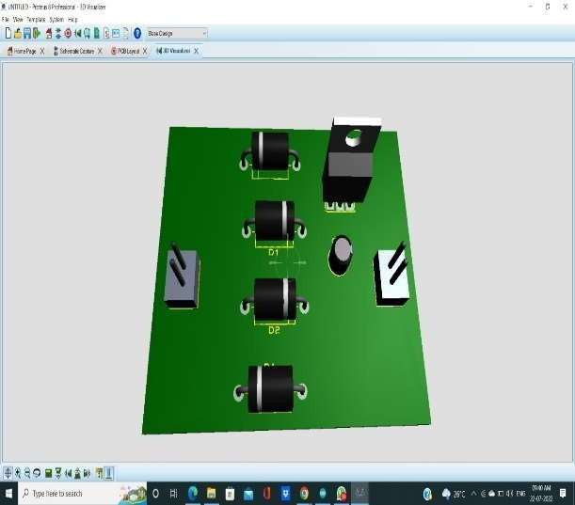
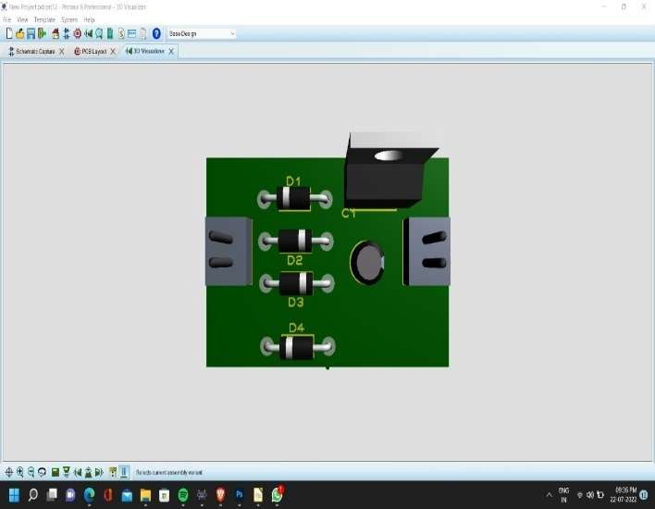
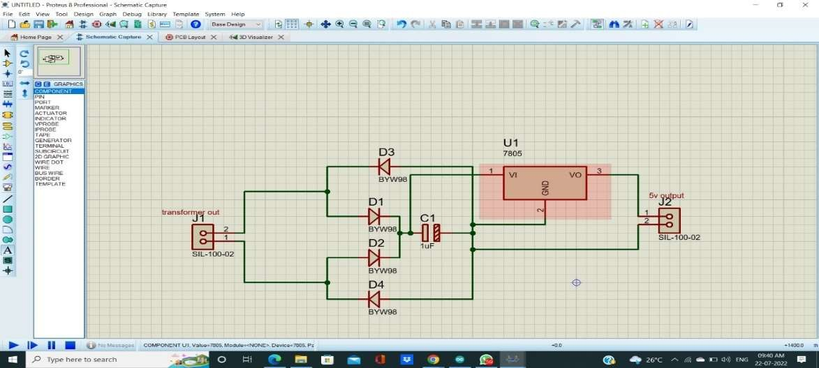
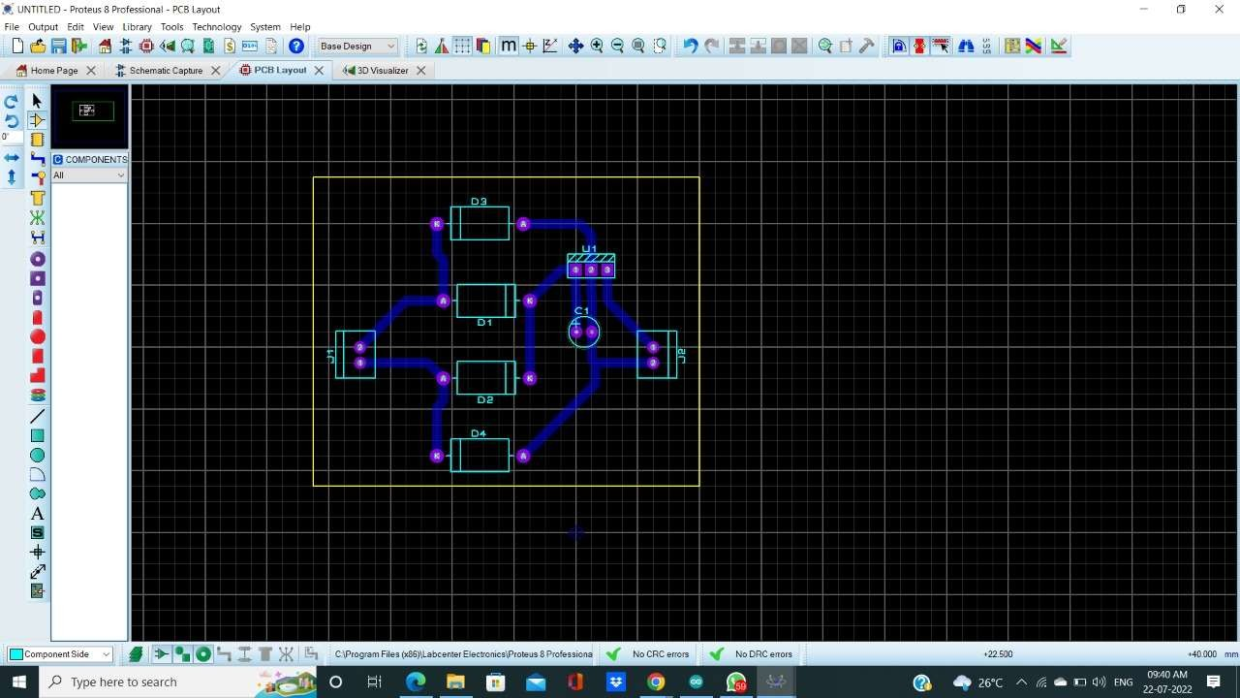
PCB LAYOUT

Slide 15
RESULT
It is evident from this project work that a spot welder can be cheaply made from low-cost with locally available components.
The nickel strips which are connecting between the battery cells gets successfully welded. It can also be modified by making the product automatic.
During the execution of this project more knowledge was acquired on how spot welder operate especially for welding purposes and this will help when designing more systems of this nature.

Slide 16
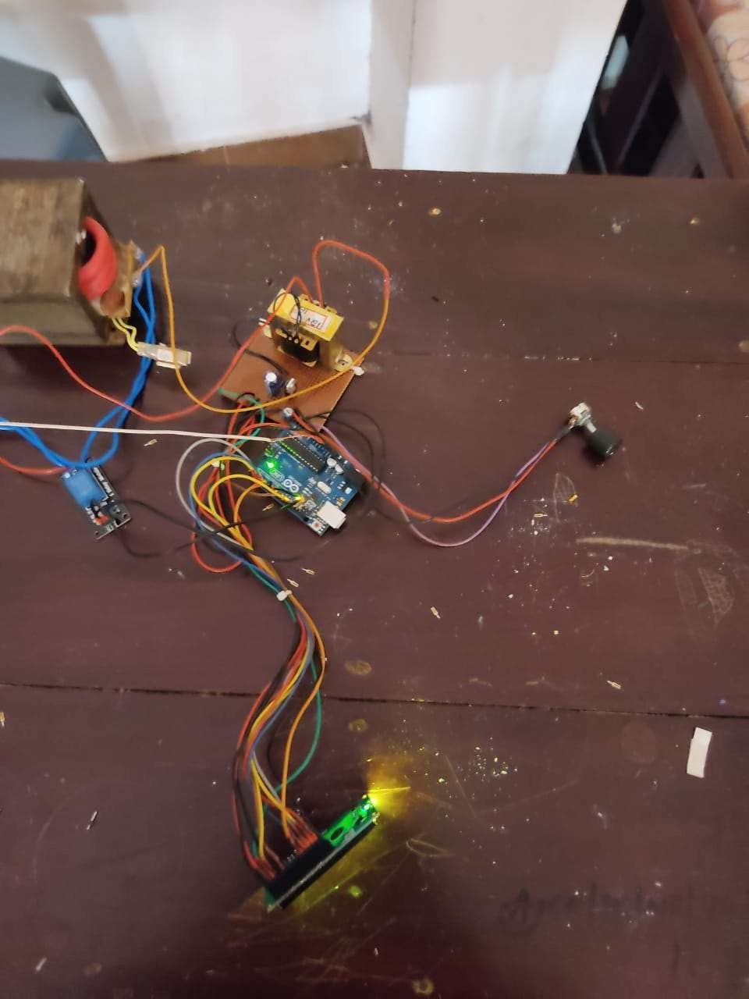
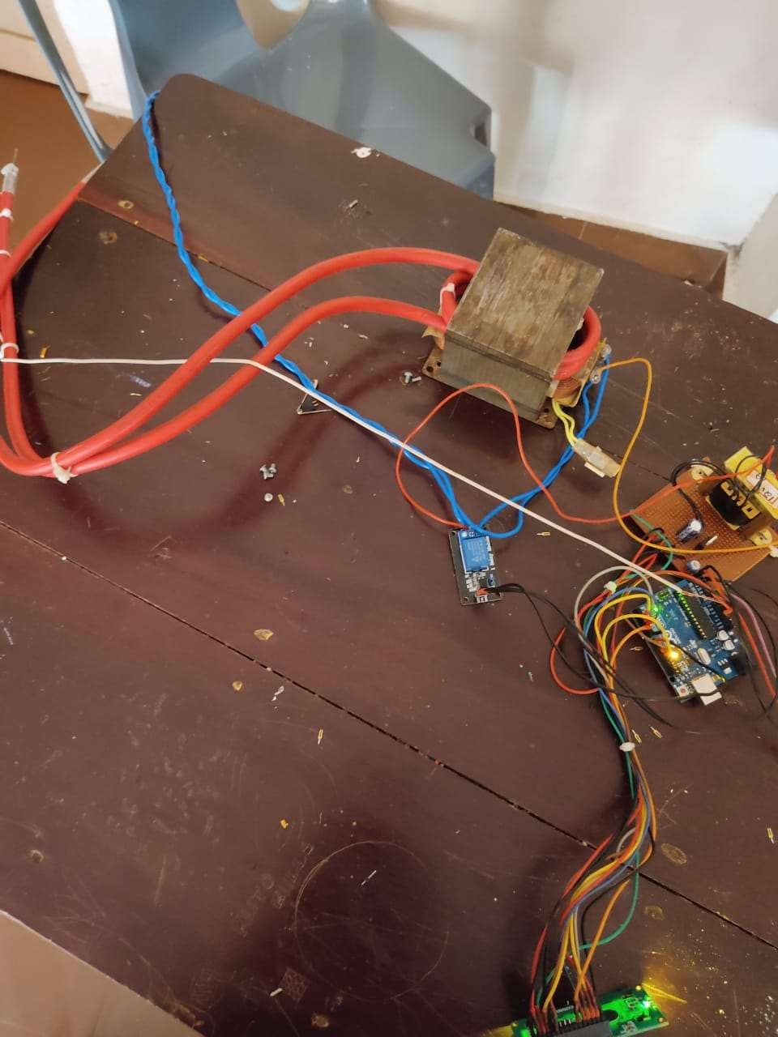
PHOTO OF CIRCUIT

Slide 17
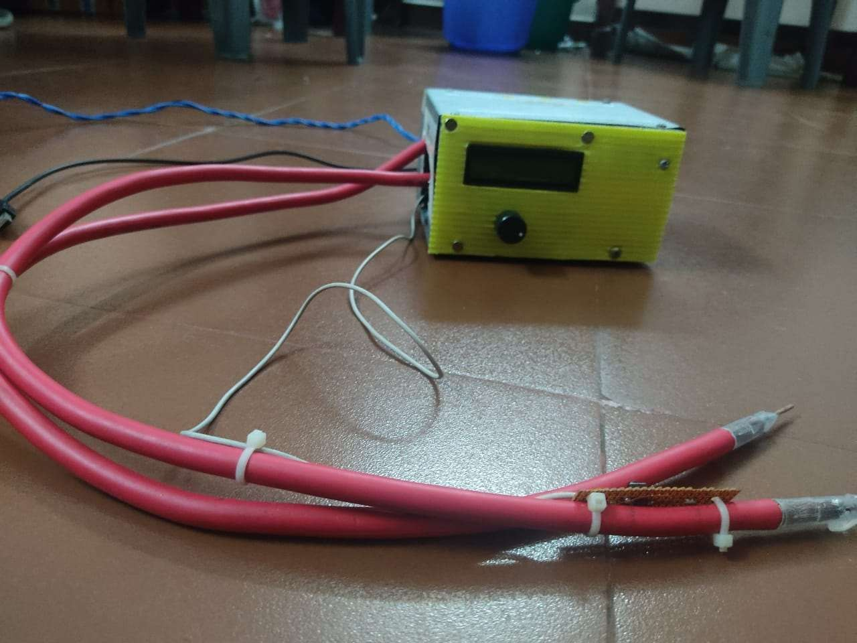
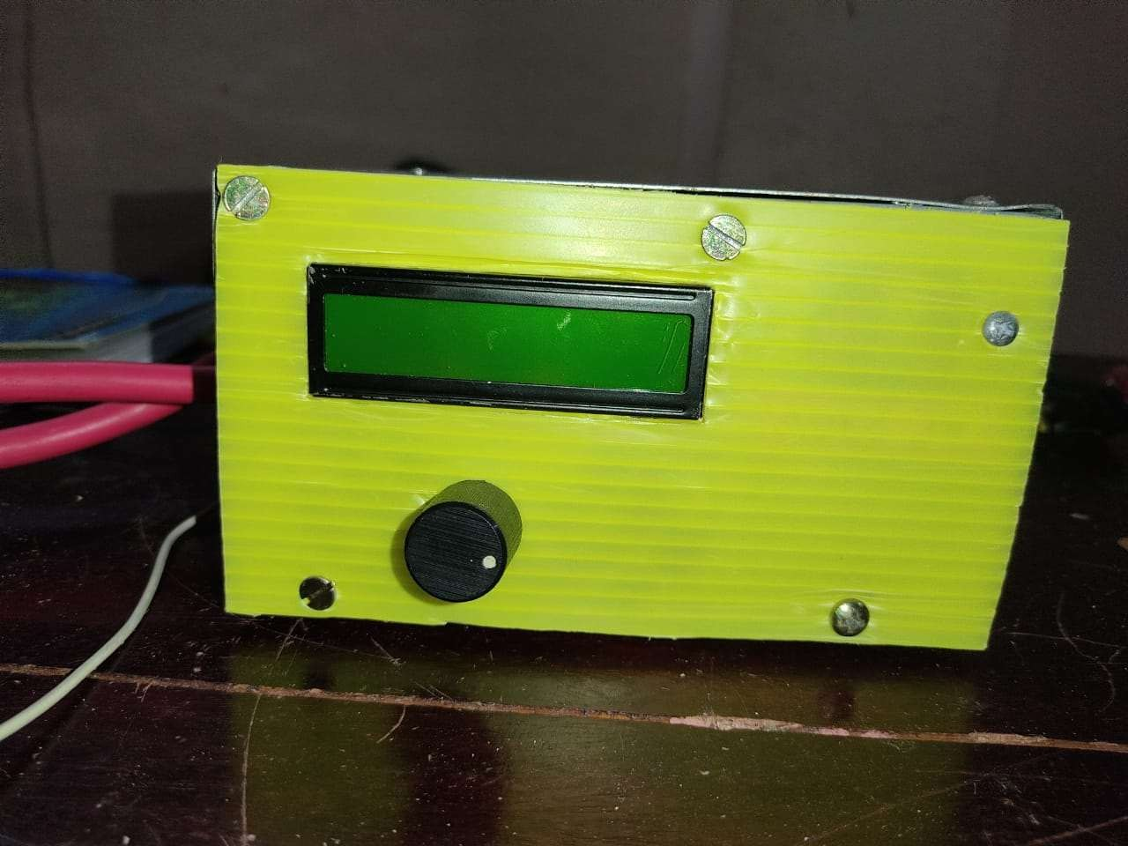
PHOTO OF PRODUCT

Slide 18
CONCLUSION
It is evident from this project work that a spot welder can be cheaply made from low-cost with locally available components.
The nickel strips which are connecting between the battery cells gets successfully welded. It can also be modified by making the product automatic.
During the execution of this project more knowledge was acquired on how spot welder operate especially for welding purposes and this will help when designing more systems of this nature.

Slide 19
REFERENCES
Introduction to resistance welding of battery pack spot welding machine (batterypackequipment.com)
5V Relay Module : Pin Configuration, Circuit, Working & Its Applications (elprocus.com)
https://en.wikipedia.org/wiki/Arduino_Uno
https://robu.in/arduino-pin-configuration/
https://en.wikipedia.org/wiki/Liquid-crystal_display
https://circuitdigest.com/article/16x2-lcd-display-module-pinout-datasheet
DIY Battery Spot Welder! : 8 Steps (with Pictures) - Instructables
DIY 18950 battery spot welder| Microoven transformer https://youtu.be/W3c242TUsvs

Slide 20
THANK YOU……..

